Slide 1
KALI Linux Tools

Slide 2

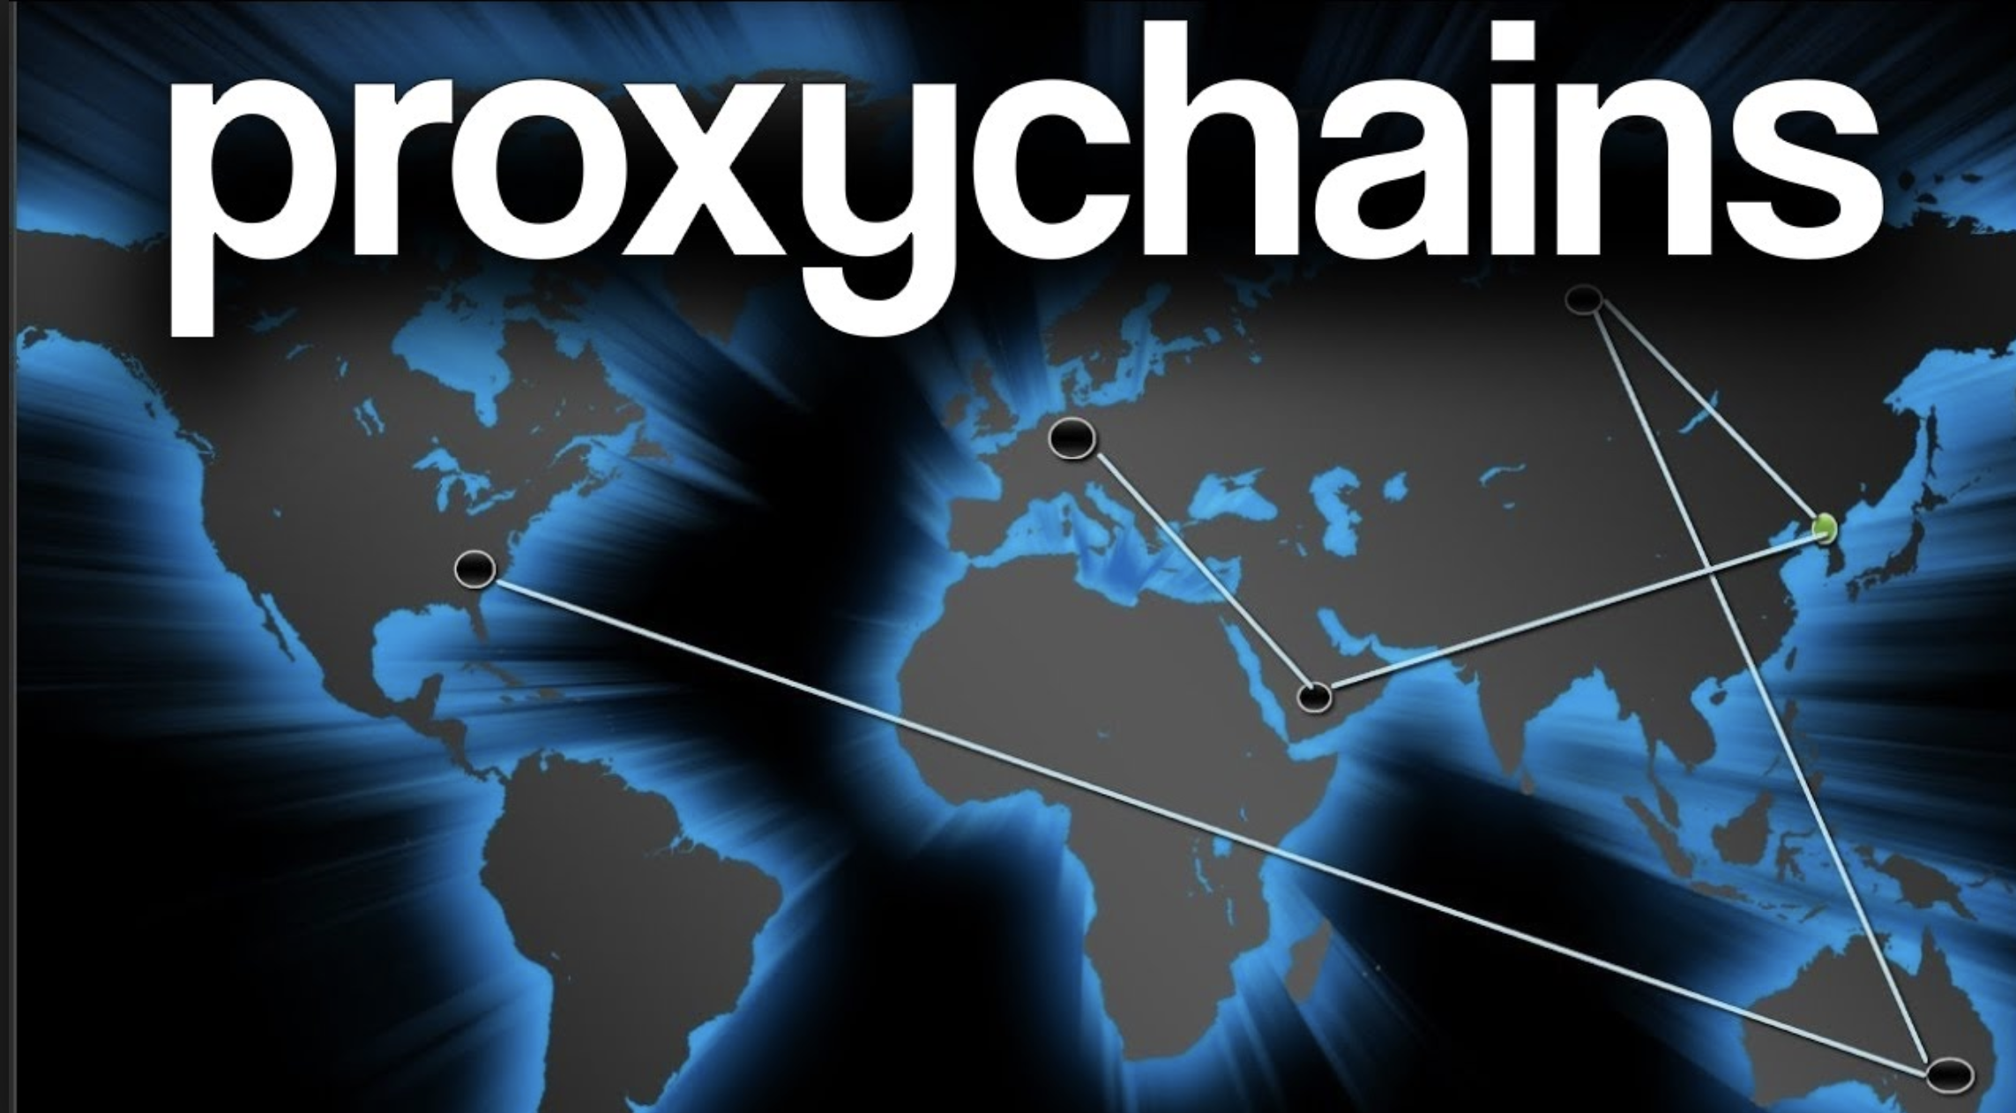

LEVELS OF ANONYMITY

Slide 3
PROXY
HTTP Based Traffic to Bring anonymity.
Examples:- Lot of Open Proxies are Posted here → https://premproxy.com/list/
You can change the Proxy Configuration to ananomize the http traffic in browser.

Slide 4
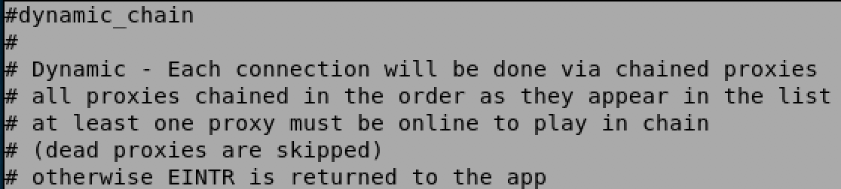
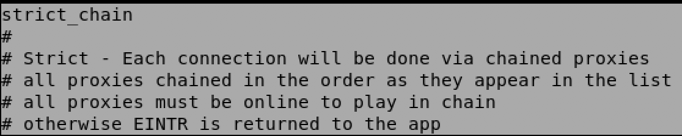
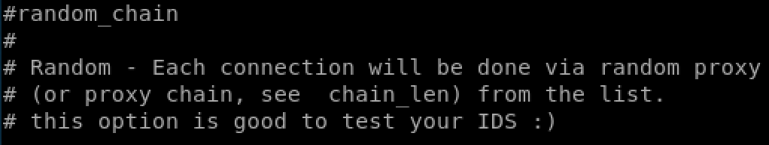
Proxy CHAINS
Proxy chains is a software that provides anonymity to anything that you are doing
http , socks4, socks5 , tunneling proxifier with DNS. Proxy Chains do SNAT – Source
Network Address Translation

Slide 5
1. Information GATHERING

